Slide 1
Switch-Centric Data Center Network Architecture

Slide 2
Outline
Data center network basics
Switch-centric design approach to scalable data center networking
Fat-tree
Portland

Slide 3
What is a Data Center Network?
Network infrastructure that inter-connects a large number of commodity servers
Each server has an Ethernet interface: 1~10Gbps
Two types of data communications
External communications to Internet hosts
How each client user requests/receives services: gmail, google service, online shopping, …
Internal communications among servers
Used for internal data storage, processing and transfer by cloud computing software
Network that serves both “commodity servers” and user clients
Network functions: routing & forwarding data

Slide 4
Desired Properties of Solutions
Scaling
100s to 100,000s of servers
High speed
1~100s Gbps for server-to-server communications
No changes in apps; Support of Layer 2 (Ethernet)
Cost effective
Low power consumption & heat emission
Cheap infrastructure
Fault tolerance
Robust against component failures

Slide 5
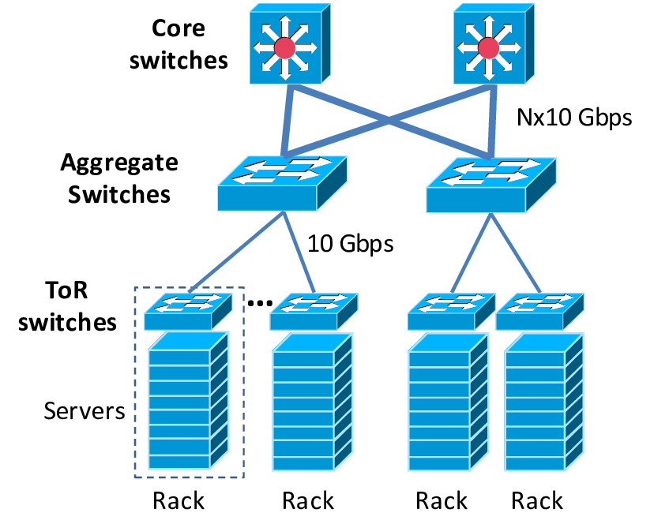
Initial Design of DCN (CISCO)

Slide 6
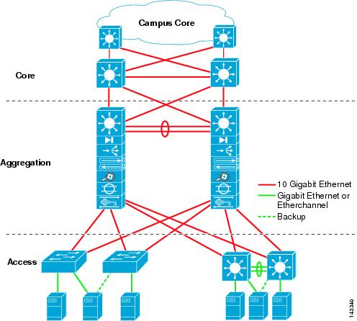
Scale to Large Server Population: Scale Up

Slide 7
Scaling and Routing
Scale up
Add more layers in the hierarchy to scale to larger # of servers
Starting from 2~3-layer hierarchy
Similar to the Internet DNS system
Spanning tree based forwarding
Build a tree for data forwarding (running Internet layer-2 spanning tree protocol)
Root: core switches
Servers as leaf of the tree
Single path between any two servers
No forwarding loops

Slide 8
Problem With common DC topology
Expensive hardware cost
Core switches, aggregation switches
Fault tolerance
Tree like topology offers a single physical path for each pair of servers
Single point of failure
Reduced speed for server-to-server communication
Over subscription of links higher up in the topology
Trade off between cost and provisioning

Slide 9
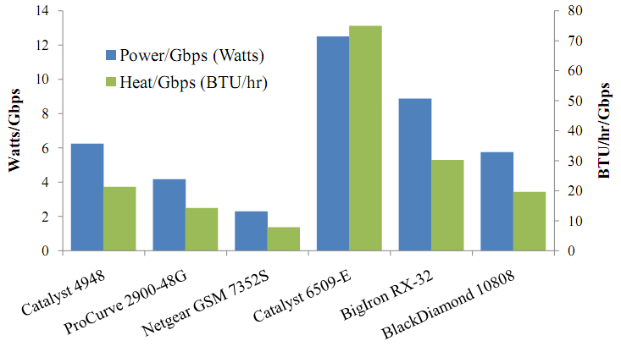
Cost of maintaining switches
Notes:
Netgear ~ 3K
Procurve – 4.5K

Slide 10
Need for Layer-2 In DC
Certain monitoring apps require server with same role to be on the same VLAN
Using same IP on dual homed servers
Allowing growth of server farms.

Slide 11
Forwarding & Routing: Review of Layer 2 & Layer 3
Layer 2
One spanning tree for entire network
Prevents looping
Ignores alternate paths
Layer 3
Internet routing design
Shortest path routing between source and destination
Best-effort delivery
Notes:
In this talk, I shall next explain the problems with current middlebox deployment mechanisms.
I shall then describe how our solution, the policy-aware switching layer simplifies middlebox deployment and achieves the properties I mentioned earlier.
I shall briefly discuss related work, and our prototype implementation and evaluation of the policy-aware switching layer.

Slide 12
Switch-centric Solution
Switch-centric solution scheme
Innovations are at the switch that interconnects servers
Modifying the switch design and operations
Servers remain unchanged
How to scale? Scale out
Expand horizontally to scale to large # of servers
Do not increase depths in the hierarchy
Examples:
Fat tree
Portland

Slide 13
FAT Tree based Solution
An example of switch-centric design
Servers remain unchanged
Connect servers using a Fat-Tree topology
Infrastructure consist of cheap devices
Layer-2 switch is comparably cheaper than Layer-3 routers
Each port supports same speed as servers
All devices can transmit at line speed if packets are properly distributed along existing paths

Slide 14
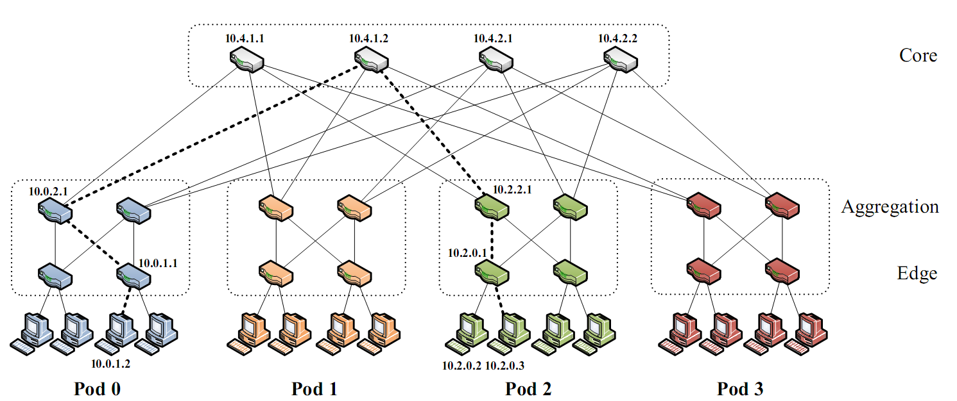
Fat-Tree Topology

Slide 15
Problems with a vanilla Fat-tree
Layer-3 routing will only use one of the existing equal-cost paths
Packet re-ordering occurs if layer 3 blindly takes advantage of path diversity
Packets from the same data session may traverse different paths (with different core/aggregation switches)

Slide 16
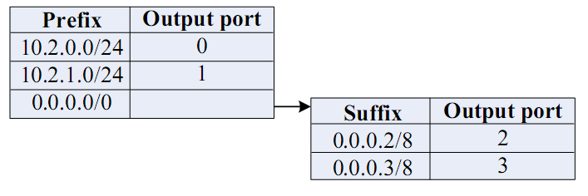
FAT-tree Modified
Enforce special addressing scheme
Allows servers attached to the same switch to route only through the switch
Allows intra-pod traffic to stay within pod
10 (unused).PodNumber.switchnumber.Endserver
Use two-level look-ups to distribute traffic and maintain packet ordering.

Slide 17
2 Level Look-ups
First level is prefix lookup
Used to route down the topology to servers
Highest 3 bytes (prefix /24)
Second level is a suffix lookup
Lowest 1 byes (suffix /8)
Used to route up towards core
Diffuses and spreads out traffic
Maintains packet ordering by using the same ports for the same end servers

Slide 18
Summary
Scaling is a main challenge for data center networking
Traditional design cannot scale while ensuring fault tolerance, load balancing
New design approach: scale out rather than scale up
FatTree: switch-based scale-out solution

Slide 19
PortLand (Sigcomm’09)
Core idea: adapt Layer-3 solutions (addressing and routing) to Layer-2
PortLand is a single logical layer-2 data center network fabric that scales to millions of endpoints
PortLand internally separates host identity from host location
Note IP address plays the dual roles of host ID (for TCP connection) and host location (for routing)
Uses IP address as host identifier
Introduces “Pseudo MAC” (PMAC) addresses internally to encode endpoint location
PortLand runs on commodity switch hardware with unmodified hosts/servers

Slide 20
Goals For Data Center Network Fabrics
Easy configuration and management – Plug and play
Fault tolerance, routing and addressing – Scalability
Commodity switch hardware – Small switch state
Virtualization support – Seamless VM migration

Slide 21
Layer 2 versus Layer 3 Data Center Fabrics
Technique
Plug and play
Scalability
Small Switch State
Seamless VM
Migration
Layer 2:
+ -
-
+
Flat MAC Addresses
-
+
+
-
Layer 3:
IP Addresses

Slide 22
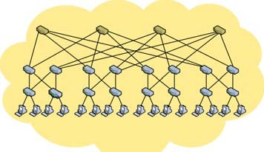

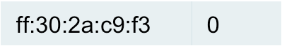
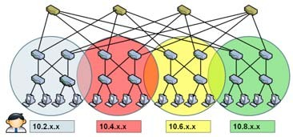

Layer 2 versus Layer 3 Data Center Fabrics
Technique
Plug and play
Scalability
Small Switch State
Seamless VM
Migration
+ -
-
+
Layer 2:
Host MAC Address
Out Port
Flat MAC
9a:57:10:ab:6e 1
No change
Flooding
Addresses
62:25:11:bd:2d 3
to IP
ff:30:2a:c9:f3 0
endpoint
…. …
- -
+
+
LSR – IP endpoint
Layer 3:
IP address
Host IP Address
Out Port
_{Addresses} Broadcast 10.2.x.x 0 can change
^{based} 10.4.x.x 1
Location-based addresses mandate manual configuration

Slide 23
Cost Consideration: Flat Address vs. Location-based Address
Commodity switches today have ~640 KB of low latency, power hungry, expensive on chip memory
– Stores 32 – 64 K flow entries
Assume 10 million virtual endpoints in 500,000 servers in data center
Flat addresses: 10 million address mappings; ~100 MB on chip memory; ~150 times the memory size that can be put on chip today
Location based addresses: 100 – 1000 address mappings; ~10 KB of memory; easily accommodated in switches today

Slide 24
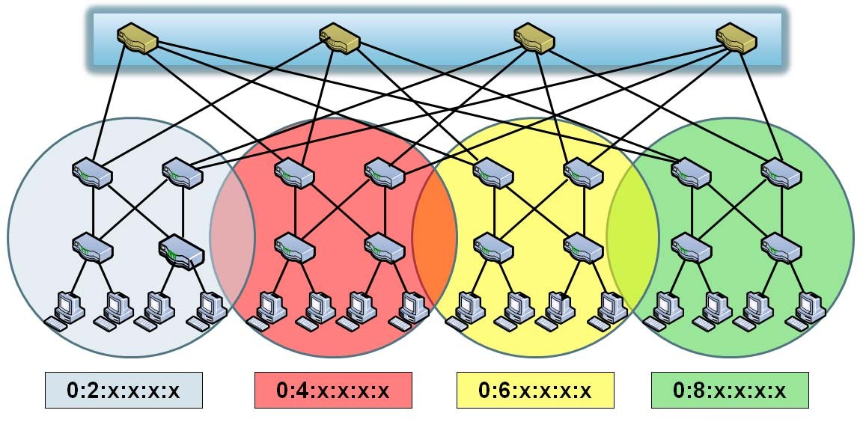

PortLand: Plug and Play + Small Switch State
+
Pair-wise communication
Auto Configuration
PMAC Address
Out Port
10 million virtual endpoints in 500,000 servers in data center
0:2:x:x:x:x 0
^{0:4:x:x:x:x 1} •100 – 1000 address mappings
0:6:x:x:x:x 2 ~10 KB of memory € easily
0:8:x:x:x:x 3 accommodated in switches today
PortLand switches learn location in topology using pair-wise communication
They assign topologically meaningful addresses to hosts using their location
9

Slide 25
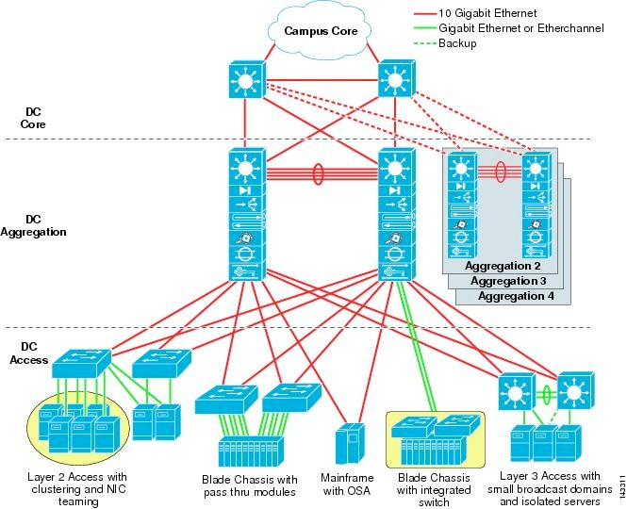
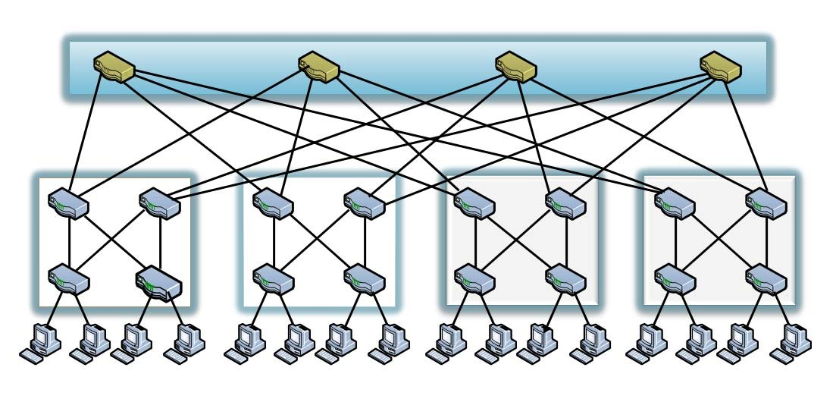
PortLand: Main Assumption
Hierarchical structure of data center networks: They are multi-level, multi-rooted trees
Cisco Recommended Configuration
Fat Tree

Slide 26
PortLand: Scalability Challenges
Challenge
State Of Art
Broadc Xast based
Broadc _{X}ast based Large s _{X}witch state
Address Resolution
Routing
Forwarding

Slide 27
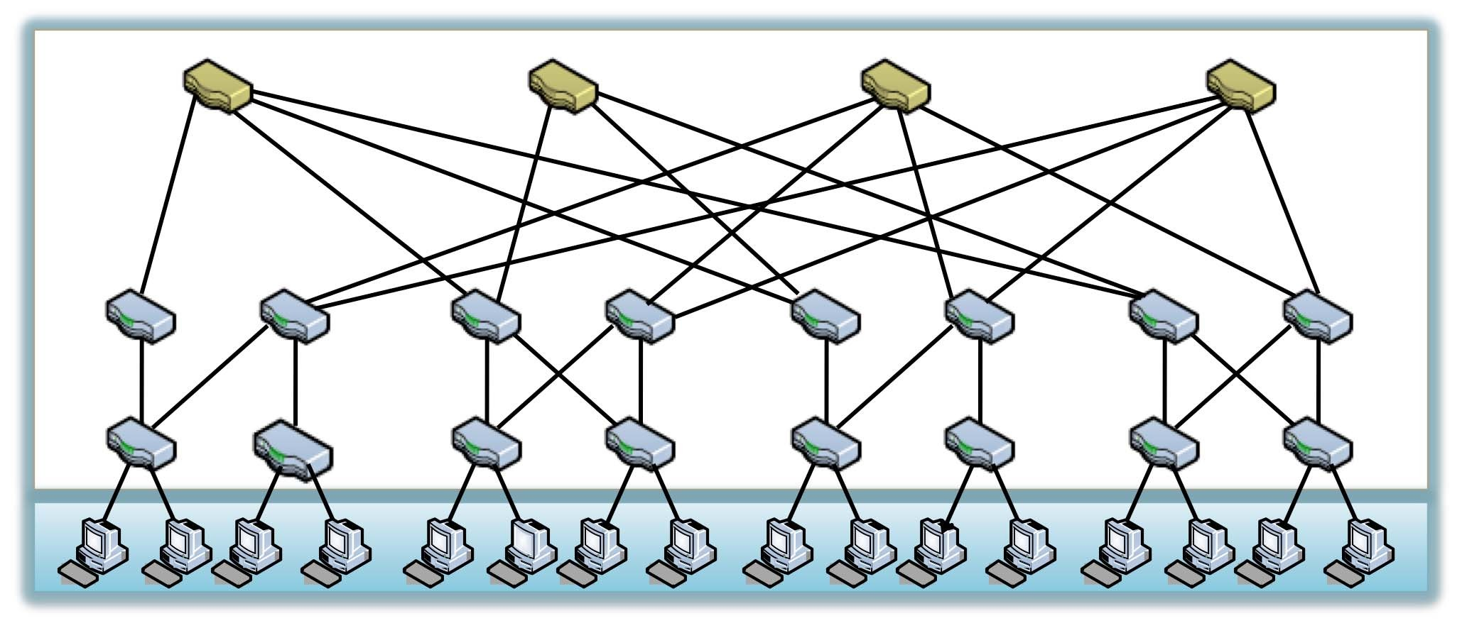
Data Center Network
Core
Switches
Aggregation
Edge
Servers

Slide 28



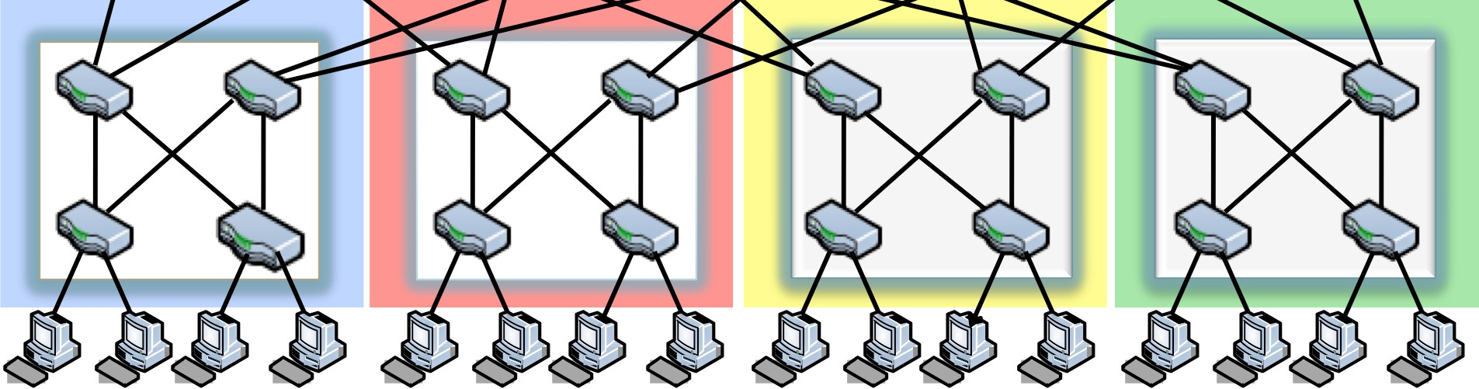


Imposing Hierarchy On A Multi-Rooted Tree
POD 0 POD 1 POD 2
POD 3
Pod Number

Slide 29

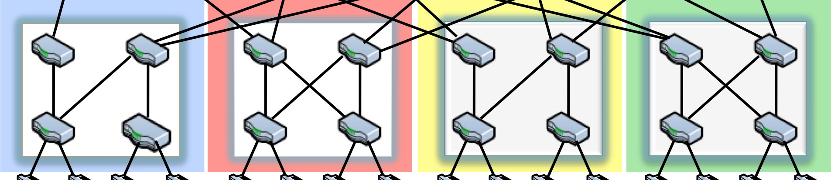

Imposing Hierarchy On A Multi-Rooted Tree
0 1
0
1
0 1
0 1
Position Number

Slide 30
Imposing Hierarchy On A Multi-Rooted Tree
0 1
0
1
0 1
0 1
PMAC: pod.position.port.vmid

Slide 31
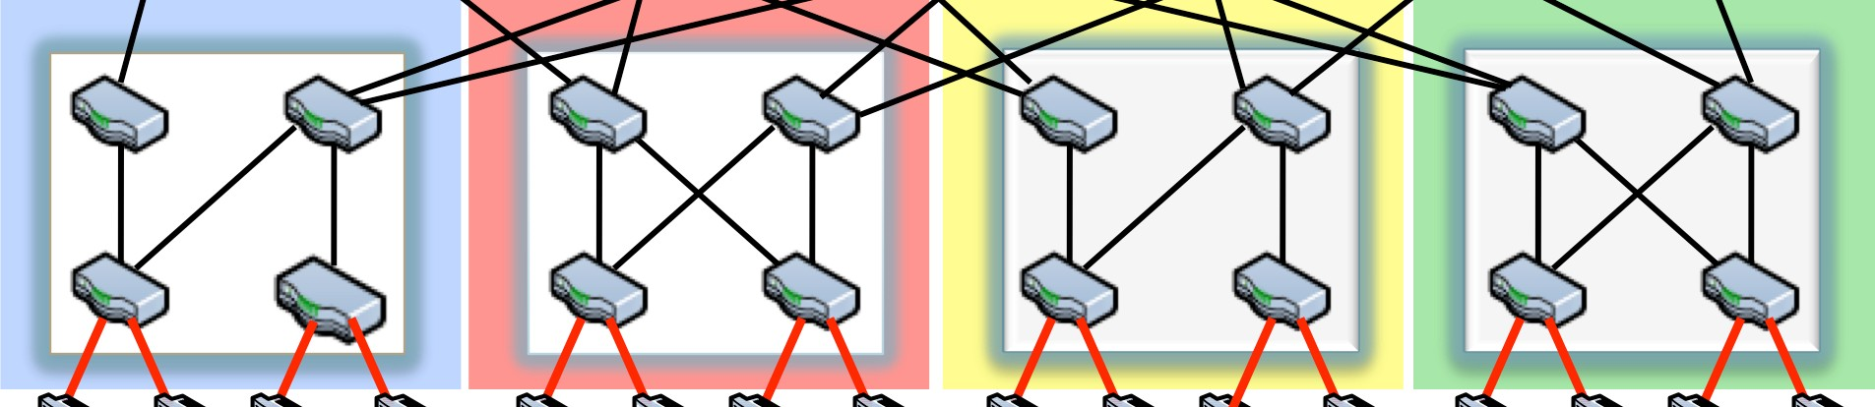

Imposing Hierarchy On A Multi-Rooted Tree
0 1
0
1
0 1
0 1
PMAC: pod.position.port.vmid

Slide 32
Imposing Hierarchy On A Multi-Rooted Tree
0 1
0
1
0 1
0 1
PMAC: pod.position.port.vmid

Slide 33


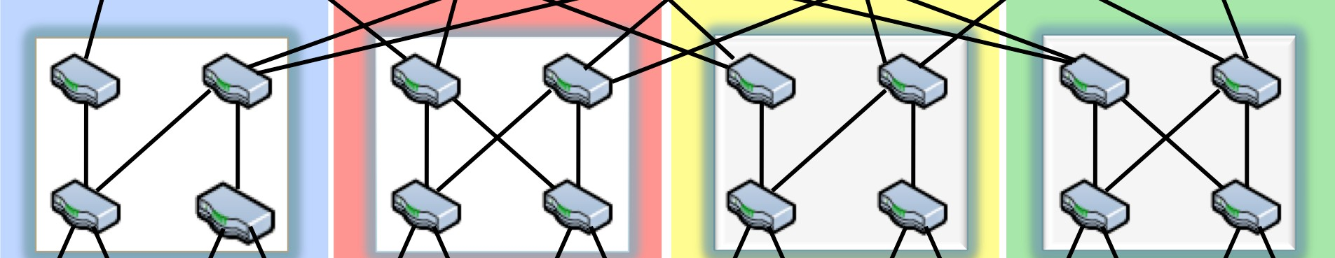
Imposing Hierarchy On A Multi-Rooted Tree
0 1
0
1
0 1
0 1
00:00:00:02:00:01
00:01:00:02:00:01
00:02:00:02:00:01
00:03:00:02:00:01
00:00:00:03:00:01
00:01:00:03:00:01
00:02:00:03:00:01
00:03:00:03:00:01
00:00:01:02:00:01
00:01:01:02:00:01
00:02:01:02:00:01
00:03:01:02:00:01
00:00:01:03:00:01
00:01:01:03:00:01
00:02:01:03:00:01
00:03:01:03:00:01

Slide 34


PortLand: Location Discovery Protocol
Location Discovery Messages (LDMs) exchanged between neighboring switches
Switches self-discover location on boot up
Location characteristic Technique
Tree level / Role Based on neighbor identity
2) Pod number
Aggregation and edge switches agree on pod number
3) Position number
Aggregation switches help edge switches choose unique position number

Slide 35
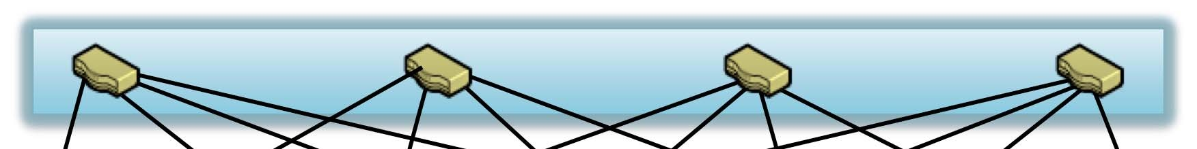
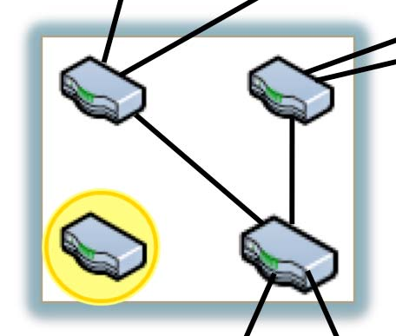
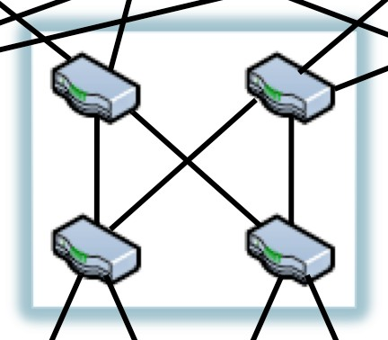
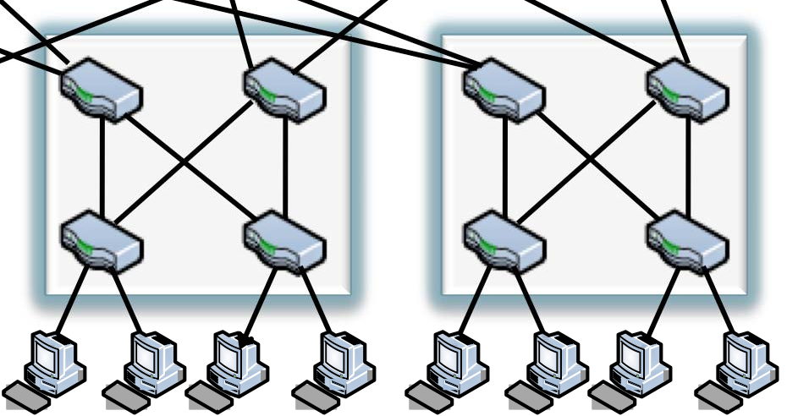

PortLand: Location Discovery Protocol
Switch Identifier
Pod Number
Position
Tree Level
A0:B1:FD:56:32:01 ?? ?? ??

Slide 36
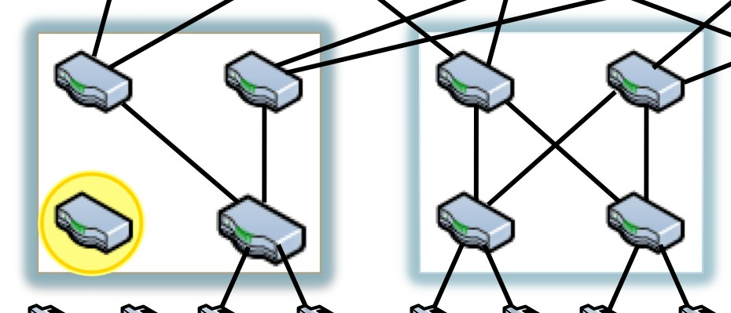
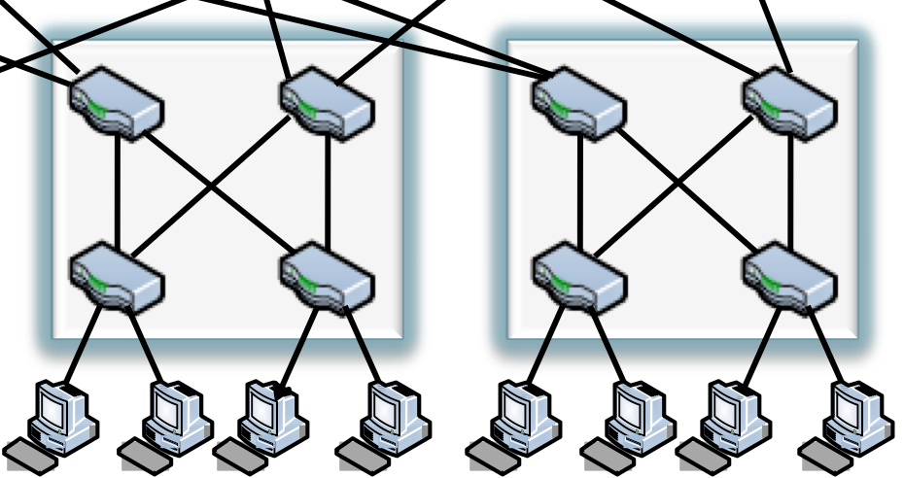


PortLand: Location Discovery Protocol
Switch Identifier
Pod Number
Position
Tree Level
A0:B1:FD:56:32:01 ?? ?? ??

Slide 37
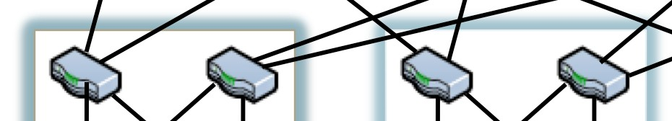


PortLand: Location Discovery Protocol
Switch Identifier
Pod Number
Position
Tree Level
0
A0:B1:FD:56:32:01 ?? ?? ??

Slide 38
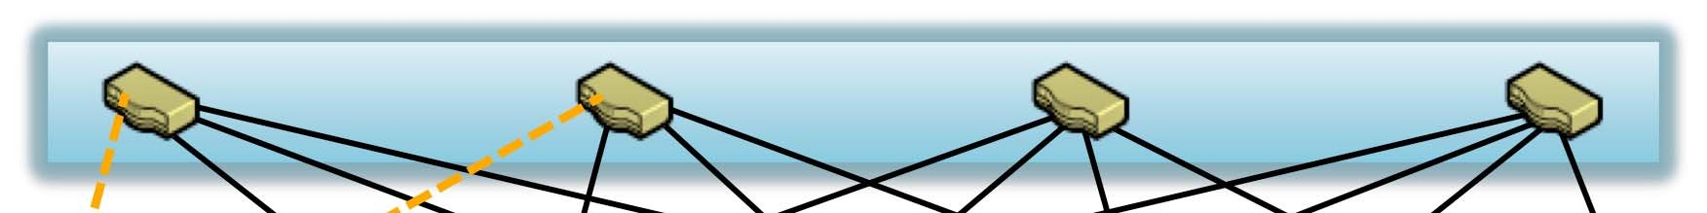
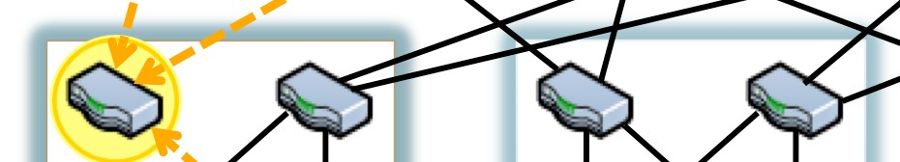

PortLand: Location Discovery Protocol
Switch Identifier
Pod Number
Position
Tree Level
B0:A1:FD:57:32:01 ?? ?? ??

Slide 39


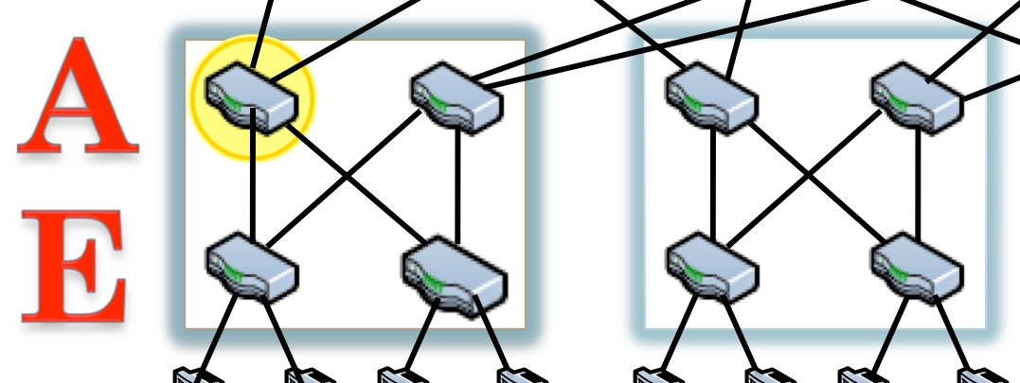
PortLand: Location Discovery Protocol
Switch Identifier
Pod Number
Position
Tree Level
B0:A1:FD:57:32:01 ?? ?? 1
??

Slide 40
PortLand: Location Discovery Protocol
Switch Identifier
Pod Number
Position
Tree Level
B0:A1:FD:57:32:01 ?? ?? 1
??

Slide 41
PortLand: Location Discovery Protocol
Propose 1
Switch Identifier
Pod Number
Position
Tree Level
A0:B1:FD:56:32:01 ?? ?? 0

Slide 42
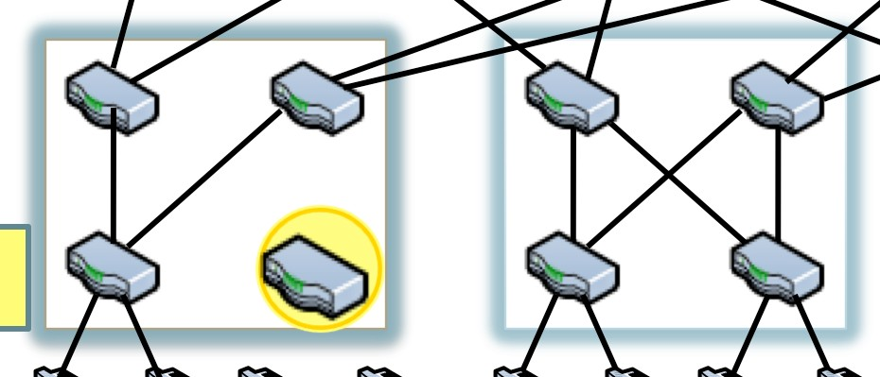


PortLand: Location Discovery Protocol
Propose 0
Switch Identifier
Pod Number
Position
Tree Level
D0:B1:AD:56:32:01 ?? ?? 0

Slide 43
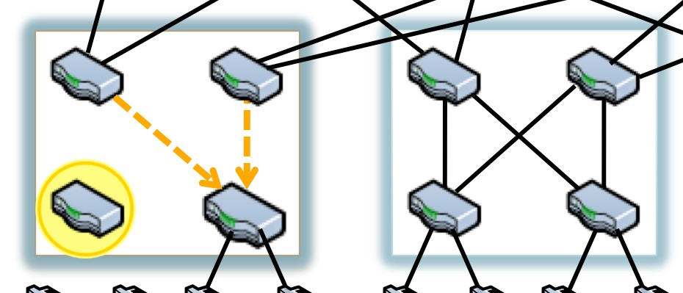
PortLand: Location Discovery Protocol
Yes
Switch Identifier
Pod Number
Position
Tree Level
A0:B1:FD:56:32:01 ?? 1 0
??

Slide 44
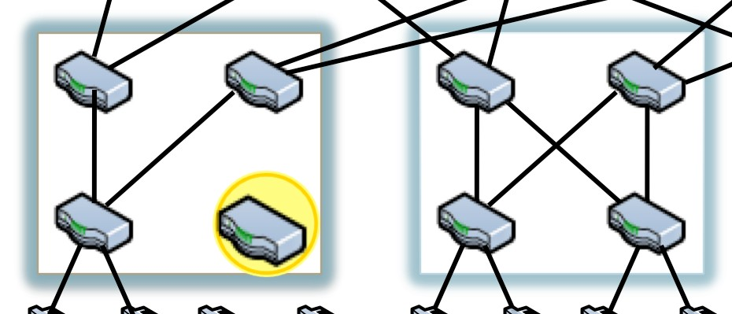
PortLand: Location Discovery Protocol
Fabric Manager
Switch Identifier
Pod Number
Position
Tree Level
D0:B1:AD:56:32:01 ?? 0 0

Slide 45
PortLand: Location Discovery Protocol
Fabric Manager
0
Switch Identifier
Pod Number
Position
Tree Level
D0:B1:AD:56:32:01 ?? 0 0

Slide 46
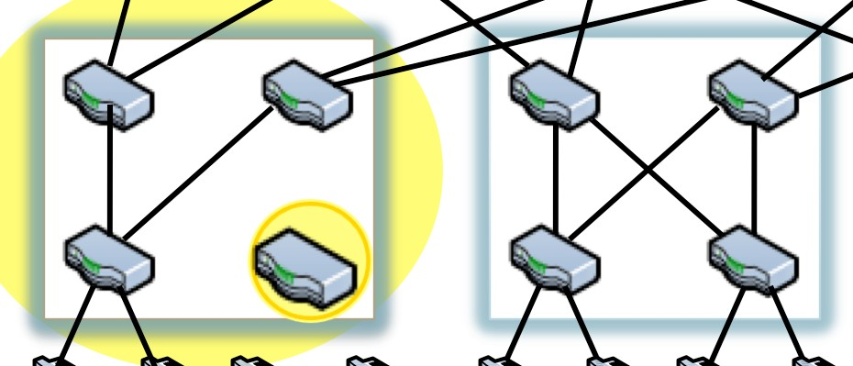

PortLand: Location Discovery Protocol
Fabric Manager
Pod 0
Switch Identifier
Pod Number
Position
Tree Level
0
D0:B1:AD:56:32:01 0 0 0
??

Slide 47
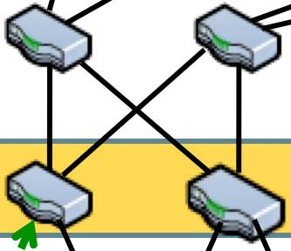
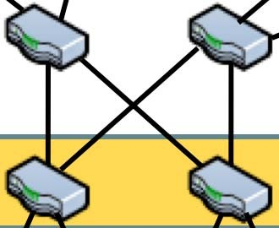
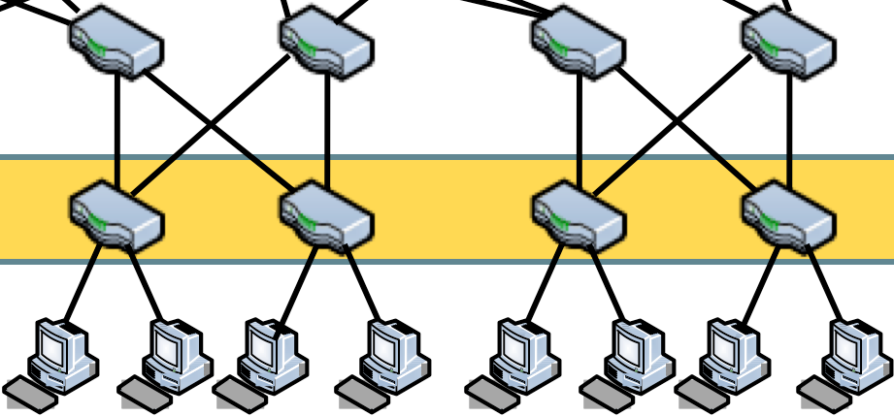


PortLand: Name Resolution
Intercept all ARP packets

Slide 48
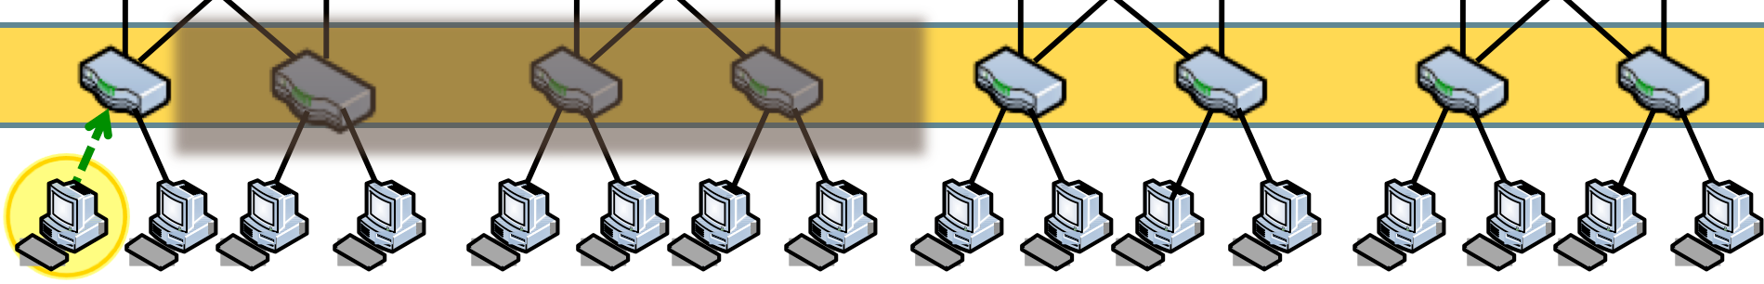

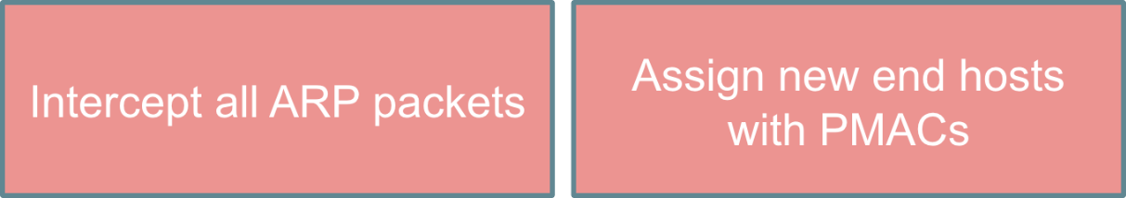
PortLand: Name Resolution
Actual MAC
Pseudo MAC
00:19:B9:FA:88:E2
00:00:01:02:00:01
Assign new end hosts with PMACs

Slide 49

PortLand: Name Resolution
Actual MAC
Pseudo MAC
00:19:B9:FA:88:E2
00:00:01:02:00:01
Rewrite MAC for packets entering and exiting network

Slide 50





PortLand: Name Resolution
Fabric Manager
Actual MAC
Pseudo MAC
00:19:B9:FA:88:E2
00:00:01:02:00:01

Slide 51
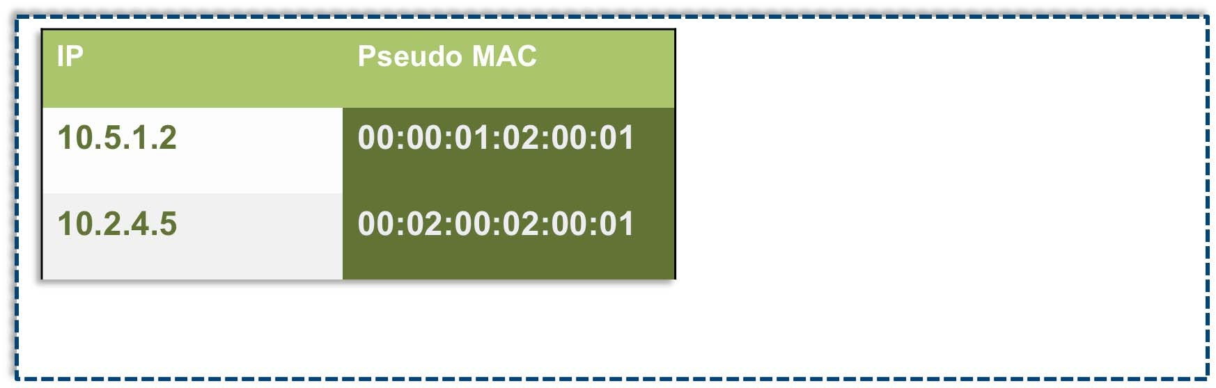
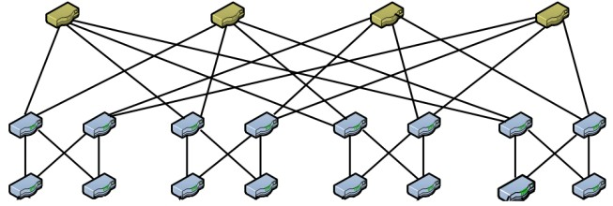


PortLand: Fabric Manager
Fabric Manager
IP Pseudo MAC
10.5.1.2 00:00:01:02:00:01
10.2.4.5 00:02:00:02:00:01
ARP mappings
Network map
Soft state
Administrator configuration

Slide 52
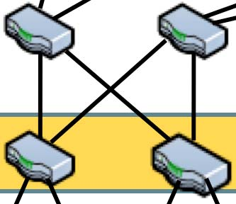
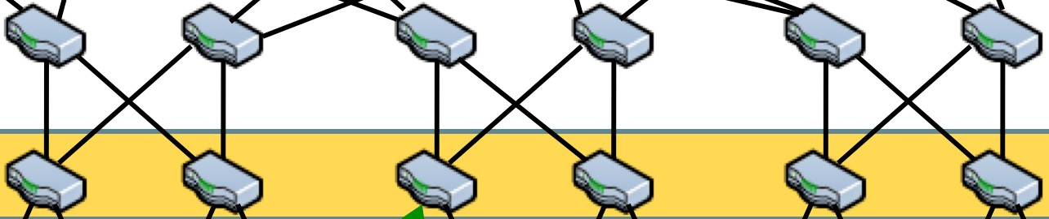


PortLand: Name Resolution
Fabric Manager
10.5.1.2
MAC ??

Slide 53
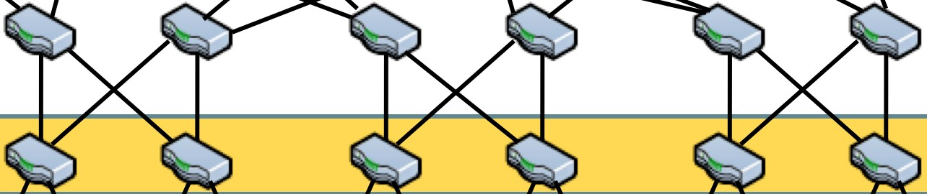

PortLand: Name Resolution
Fabric Manager
10.5.1.2
00:00:01:02:00:01

Slide 54
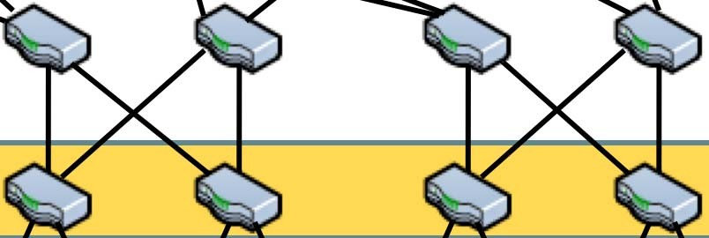
PortLand: Name Resolution
ARP replies contain only PMAC
Address | HWtype | HWAddress | Flags | Mask | Iface
10.5.1.2 | ether | 00:00:01:02:00:01 | C | eth1

Slide 55

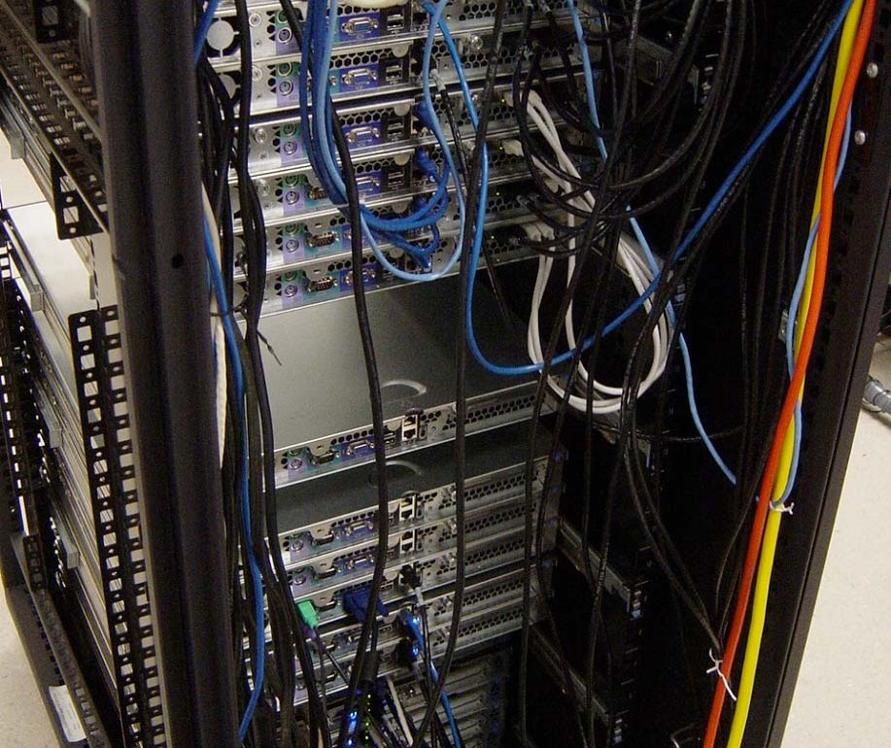
Portland Prototype
20 OpenFlow NetFPGA switches
TCAM + SRAM for flow entries
Software MAC rewriting
3 tiered fat-tree
16 end hosts

Slide 56

PortLand: Evaluation
Measurements
Configuration
Results
Network convergence time
Keepalive frequency = 10 ms
Fault detection time = 50
ms
RTO_{min} = 200ms
65 ms
TCP convergence time
Multicast convergence time
TCP convergence with VM migration
Control traffic to fabric manager
CPU requirements of fabric manager
~200 ms 110ms
RTO_{min} = 200ms
~200 ms – 600 ms
27,000+ hosts,
100 ARPs / sec per host
27,000+ hosts,
100 ARPs / sec per host
400 Mbps
70 CPU cores

Slide 57
Recap on PortLand
PortLand is a single logical layer 2 data center network fabric that scales to millions of endpoints
Modify network fabric to
Work with arbitrary operating systems and virtual machine monitors
Maintain the boundary between network and end-host administration
Scale Layer 2 via network modifications
Unmodified switch hardware and end hosts

Slide 58
Summary
New way to scale out in data center networking design
Switch-centric solution approach
Keep the servers intact
Modify the switches
Migrate the Layer-3 (IP) solution ideas to Layer 2
Addressing (PMAC): encoding location info
Not flat addressing any more
Forwarding (using IP routing)?

